Slide 1
Learn Python 10
StEm OutReach

Slide 2
Agenda
Homework
Discussion: Superhero
Discussion: Fibonacci
Files
Regular Expressions
Homework
Let’s talk…

Slide 3
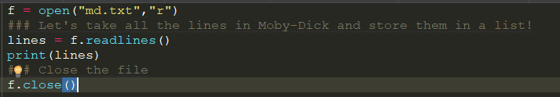
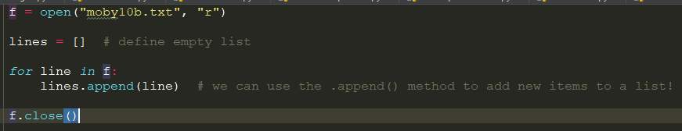
Files - Reading

Slide 4
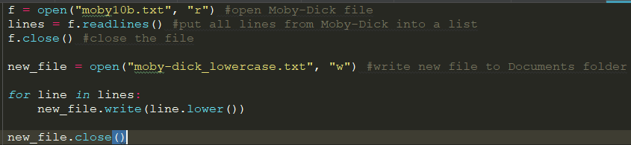
Files - Writing

Slide 5
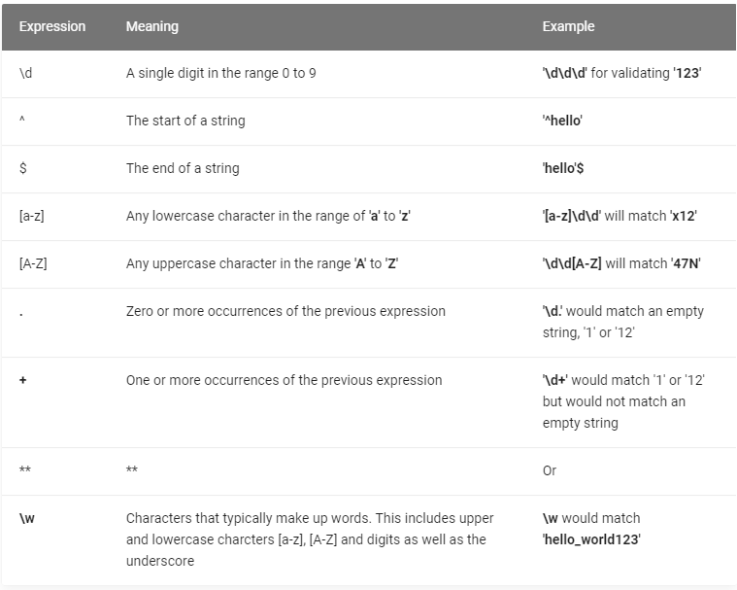
Regular Expressions
Regex101.com

Slide 6
Homework
Search for your email – Regex
Find Count of words in Moby Dick

Slide 7
Let’s Talk…

